Slide 1
Bible Text Analysis
Gaofeng Peng ,Wayne Tang, Shihong Hu, Mengxi Huang ,Mingming Xiao
Notes:
Hi everyone, the topic of our project is text analysis of the Bible.
Our team members are...

Slide 2
Introduction and EDA
Similarity Analysis
01
03
Sentiment Analysis
02
04
LDA and Clustering
Notes:
Our presentation is comprised of 4 parts:
First part we are going to do some introduction of the bible as well as the EDA part.
Second part we are going to analyze some sentiment changes throughout the bible.
Third part we are going to do some similarity analysis of different books in the bible.
Fourth part we are going to show the LDA result and clustering result from the algorithm,
and compare these results with conscious understanding.

Slide 3






What is bible?
01
Introduction and EDA

Slide 4
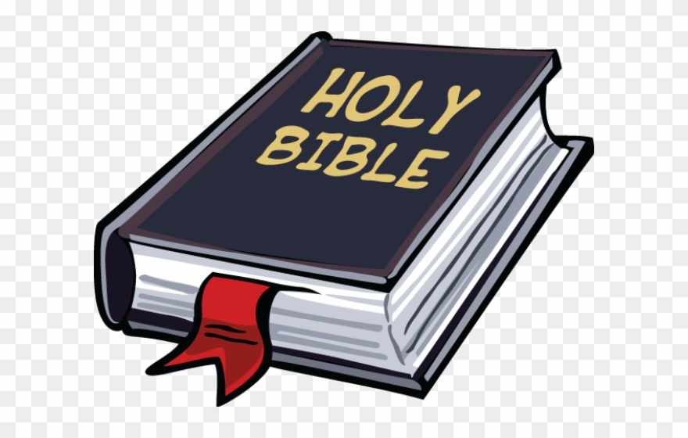

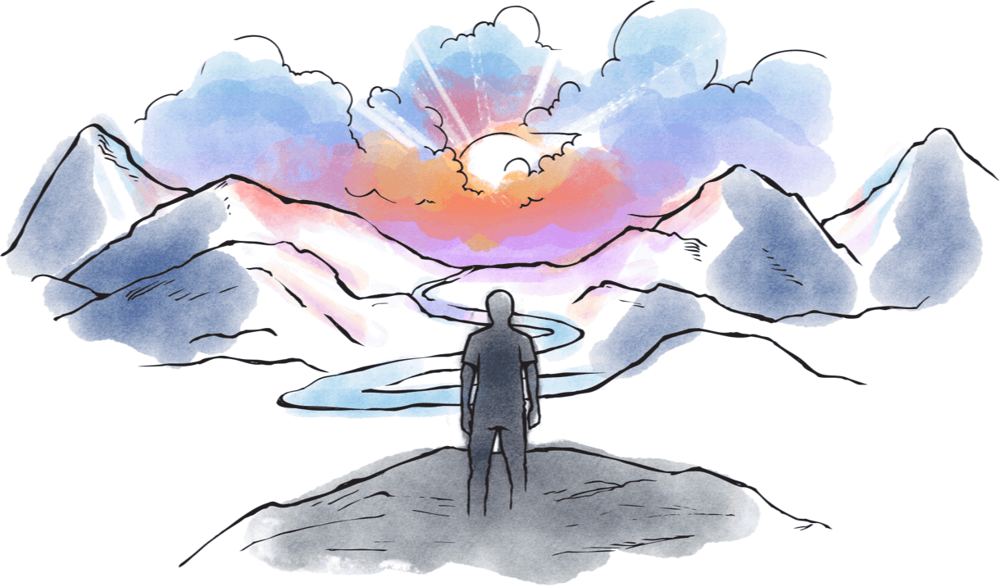
Why Bible?
Notes:
Why we choose Bible to do the analysis?
The Bible is the biggest selling book in the world and has influenced life for billions of people throughout history.
For Christians, Bible is considered a sacred text: God’s words spoken to many different people over thousands of years to help them know more about who He is and His plans for the people of the world.

Slide 5

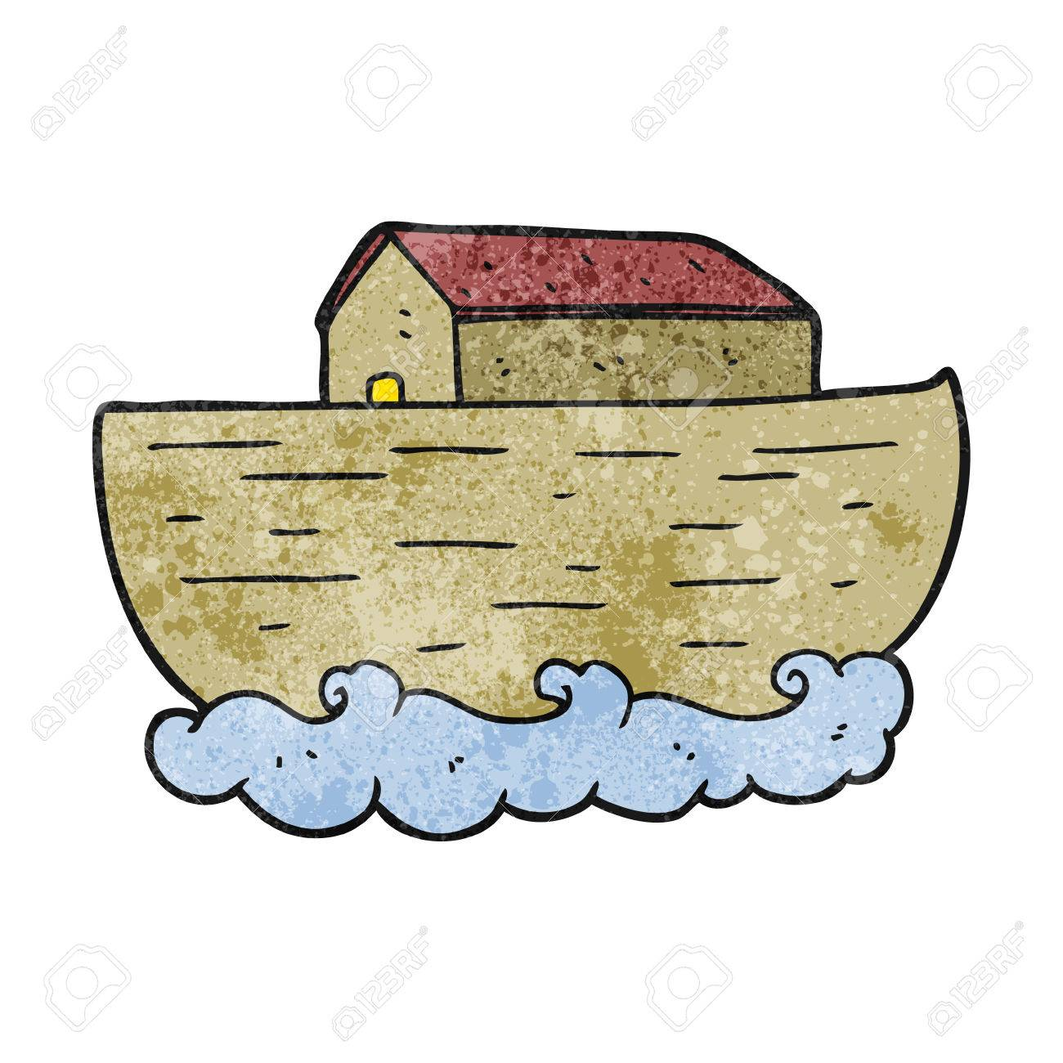
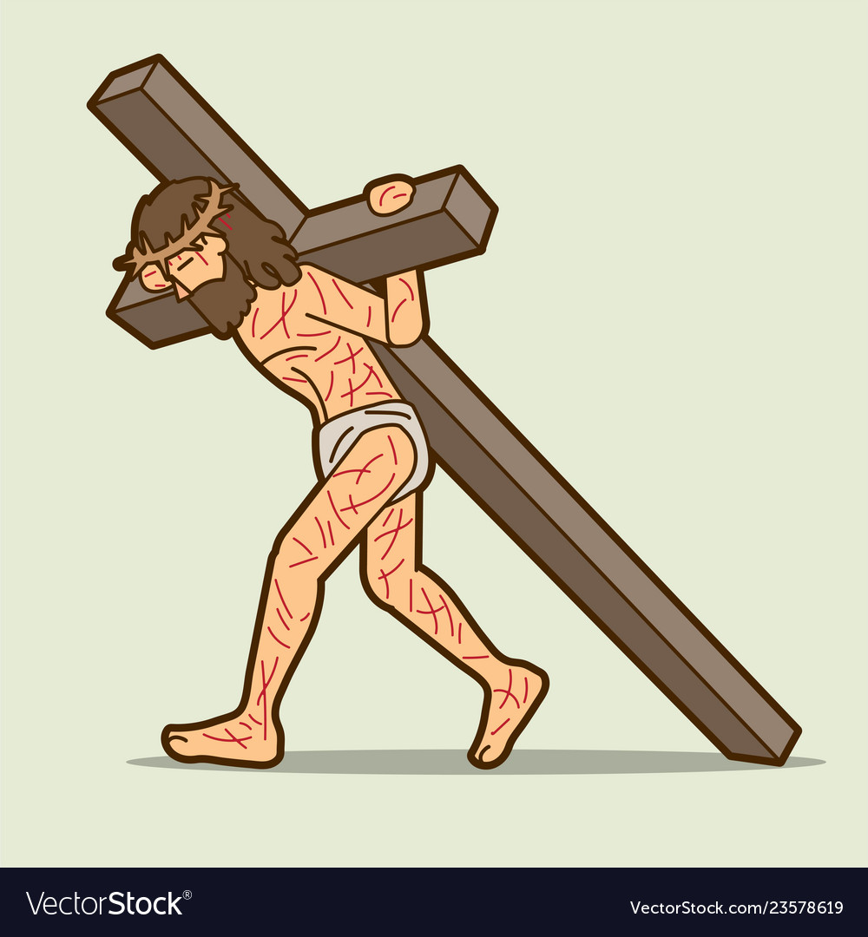
Introduction of Bible
What kind of book is Bible?
What do you know about the Bible?
Notes:
Here I list some well known stories in the bible:
Adam and Eve were tempted by the snake to eat the fruit from the tree of
the knowledge of good and evil
2. Noah built the ark and only his family survived in the big flood
3. Jesus was born through the virgin, crucified on the cross, and resurrected on the third after death

Slide 6
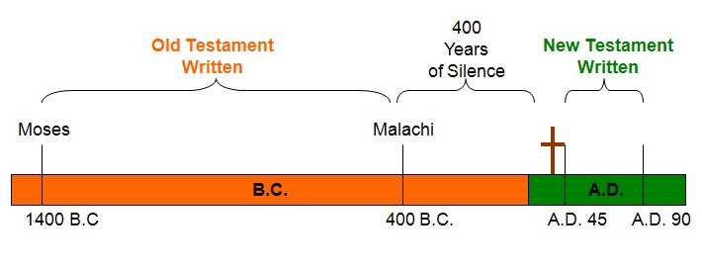
Introduction of Bible
What kind of book is Bible?
Different Books
Different Authors
Different Time
66
40
1400 B.C
to
110 A.D
Notes:
Many of you may not know that bible is actually a combination of 66 different books.
They were written by 40 different authors across over 1500 years.
The first book of bible, Genesis, was written by Moses in approximate 1400 B.C
The last book of bible, Revelation, was written by John, one of Jesus’s apostle, in 110 A.D.

Slide 7
Introduction of Bible
What kind of book is Bible?
Authors
Books
Shepherds
Fishermen
Peasants
Doctors
Tax-collectors
Kings
Law
History
Poems
Prophets
Gospel
Letters
Notes:
It is an interesting fact that God chose people from very different background to
Write the bible. There you see, among authors of the bible, there are people from very low social status, like shepherds, fishermen, peasants. But there are also doctors, tax-collectors, and even kings, who were from higher social class.
Books in the bible are about law, history, poems, prophets, gospel and letters.

Slide 8
Introduction of Bible
What kind of book is Bible?
Origin of the universe
History of Israel
Prophecies of God’s salvation
Old Testament
Birth of Jesus Christ
Life of Jesus Christ
Letters to churches
Future of the universe
New Testament
Notes:
The bible is divided into old testament and new testament.
Old testament describes how God created the universe and mankind and the history of Israel, as well as the prophecies of
God’s salvation.
The dividing point of these 2 parts is the birth of Jesus Christ. It is because Jesus is God’s ultimate plan of salvation for mankind.
So in new testament, there are 4 gospel books talks about the life and words of Jesus, and account for his death on the cross and
He revived after 3 days of his death to show he is the son of God.
The new testament also comprised of letters from Jesus’ apostles to churches around the world to clarify the faith and encourage
Believers to stand firm in the faith.
Finally, in the last book of the bible, John was inspired by God to write about the end of the universe where God promise
To create a new earth and there will be no more death and pain.

Slide 9
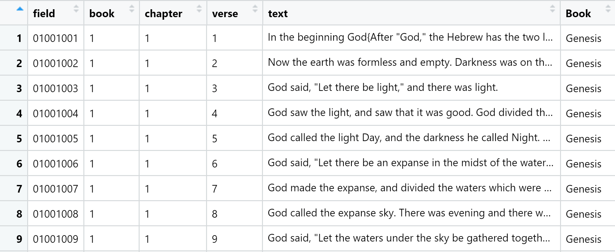
Dataset
Bible Version: World English Bible
31,102 Obs.
Notes:
We are using World English Bible as the bible version of our dataset.
It is because this version is using modern English translation and should be more easy to understand.
Each observation is a verse of the bible. A verse may comprised of one or two sentences.

Slide 10
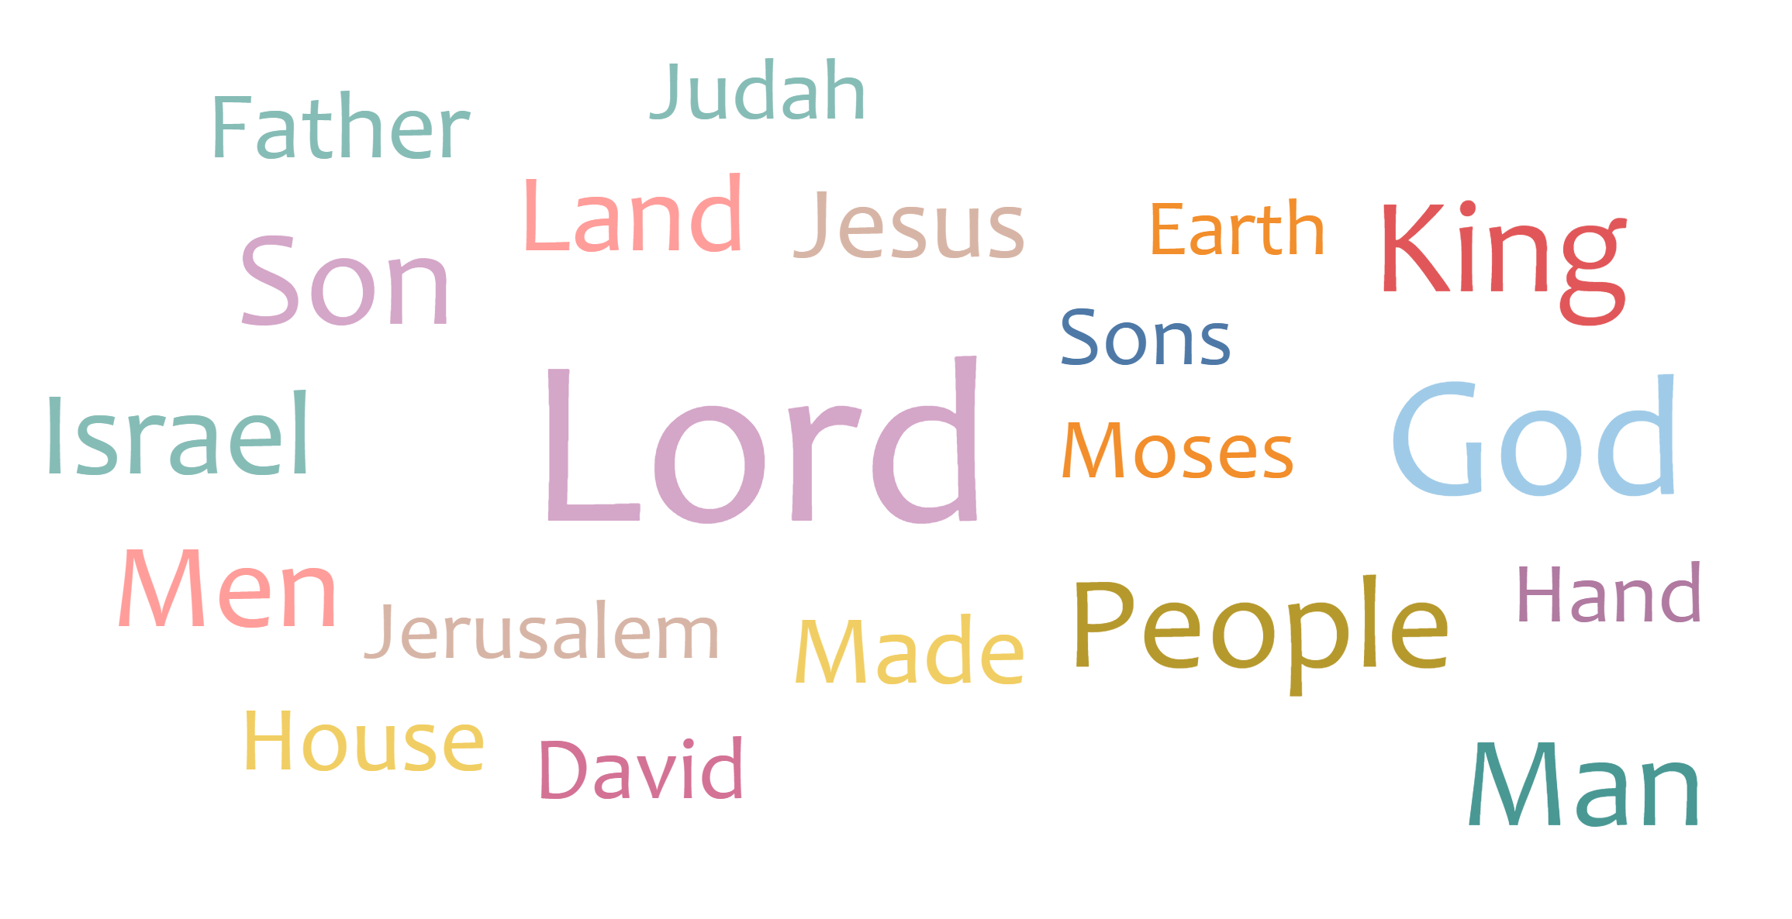
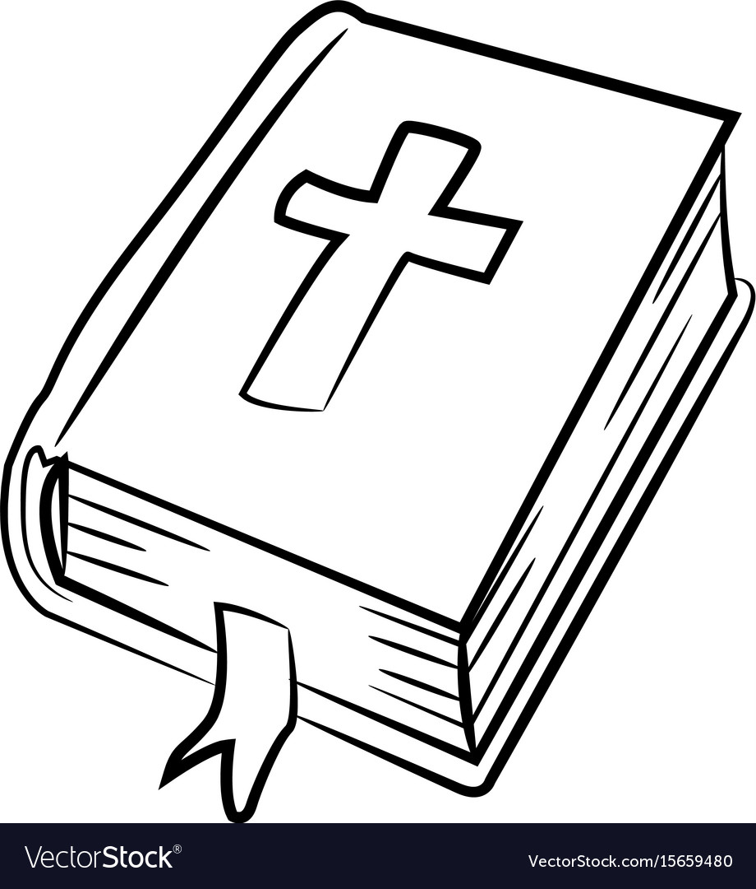
Word Cloud
Most Frequent Word in Bible
Whole Bible
Notes:
From this word cloud, we can see that the most frequent words in the whole bible are Lord, God and People.
We can be inferred that the whole bible mainly talks about the relationship between God and people.
We also see the word King, Land, House and Earth; which indicates something about God’s kingdom and possessions.
Some of the names appear here, like Israel, Jerusalem, David, Moses; are God’s chosen nation and people who are given divine words and spirits to fulfill God’s purpose to the whole world.

Slide 11
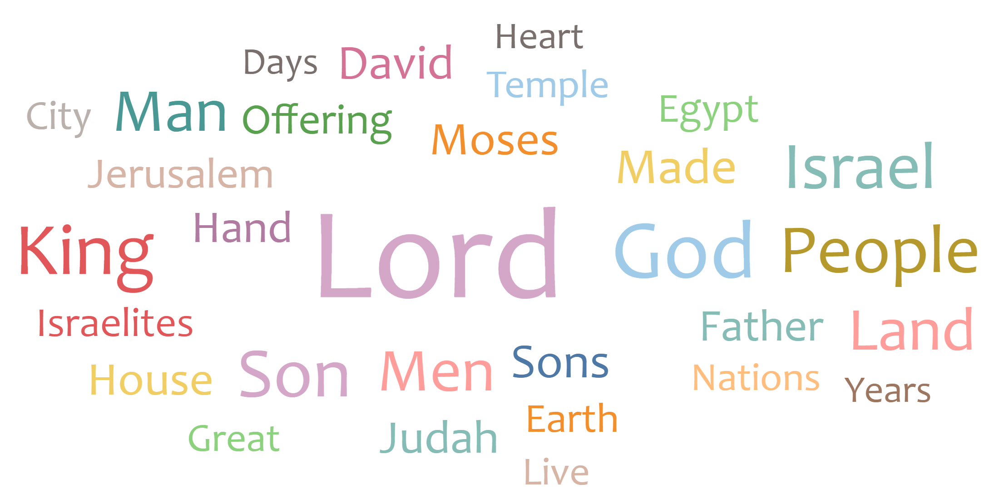
Word Cloud
Most Frequent Word in Bible
Old Testament
Notes:
Old testament mainly talk about the history of Israel, God’s chosen nation.
Israel was once the name of one person, and in the Genesis, he was chosen by God to be the ancestor of God’s chosen people.
Israel people were once slaves in Egypt, and Moses was chosen by God to lead Israel people out of Egypt, to the promised land.
Lots of miracles happened on their way out of Egypt, including passing through the red sea, where God divided the red sea for Israel
People to cross the sea.
Since Israel is a small nation, they often face the danger of being invaded of other nations.
David, the greatest king in Israel’s history, was chosen by God to defend and expand the land of Israel.
David’s son, Solomon, built the temple in Jerusalem for Israel people to worship God.

Slide 12
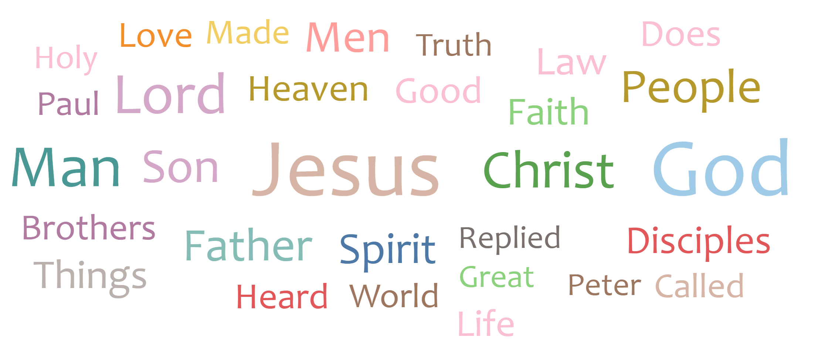
Word Cloud
Most Frequent Word in Bible
New Testament
Notes:
In the new testament, God’s salvation plan is fully revealed by sending his Son, Jesus Christ to the earth.
Jesus teach people things about heaven, and emphasize that he himself is the Truth and the Life.
The relationship between God and human is father and son.
He also talked about God’s intention for his beloved people: to live with faith, hope and love.

Slide 13
What is the change of sentiments over the whole Bible?
02
Sentiment Analysis

Slide 14
Sentiment Analysis
What is the change of sentiments over the whole Bible?
Sentiment Analysis
Notes:
Each points represent the sentiment score of each book in the bible.
In the old testament, most sentiment score are negative, because the history of Israel is filled with twist and turns.
However, in the new testament, when Jesus came showed God’s salvation plan with grace and joy, the sentiment score
Increase.

Slide 15
Which book is similar to another? And Why?
03
Similarity Analysis

Slide 16
Goal of bible similarity analysis
Calculate the similarity between books by the words used so that we know which books have identical writing style to indicate that they’re written by same author.

Slide 17
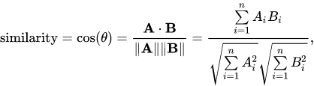
Whole process flow
Vectorization
Calculate TF-IDF
Apply LSA to reduce noise
Calculate Cos Similarity
Notes:
To calculate similarity, we compute TF-IDF and then apply LSA to reduce noise, afterward we use cosine similarity to interpret the similarity between chapter.

Slide 18
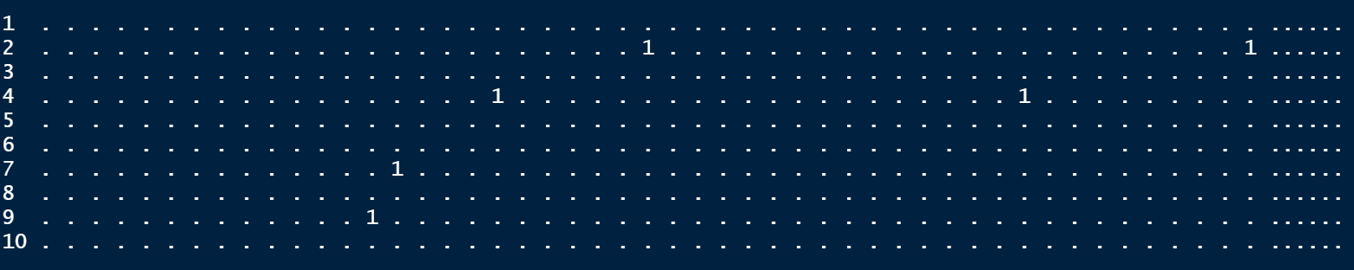
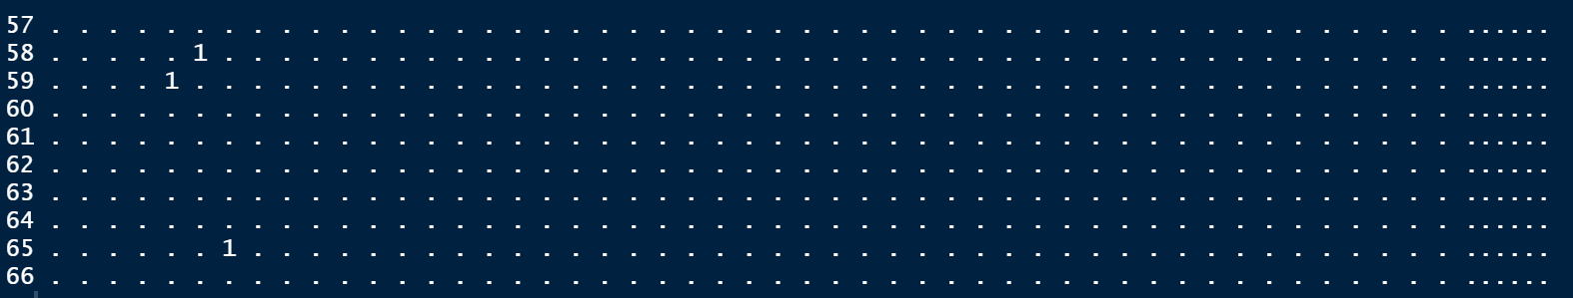
Vectorization
vocabulary
books
Notes:
Turn text in 66 books to 66 vocabulary-based vector (12,085 words vocabulary)

Slide 19
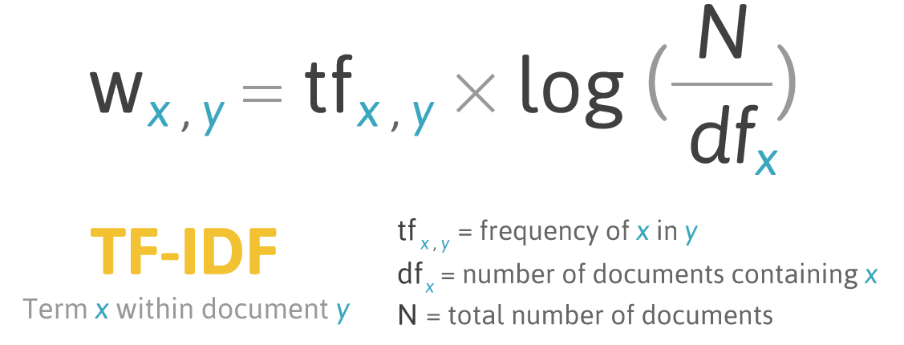
TF-IDF

Slide 20
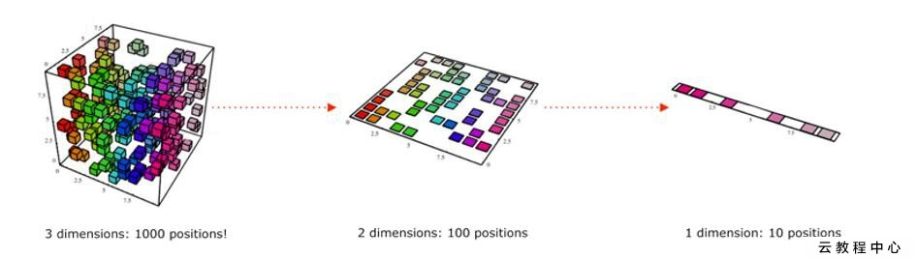
LSA (Latent semantic analysis)
LSA
12,085 columns (Words)
40 columns (Topics)
Notes:
Since the matrix is sparse and noisy(contain a lots of low frequent word), we decide to apply LSA to reduce dimension. The idea of LSA is that words will occurs in similar pieces of text if they have similar meaning.

Slide 21
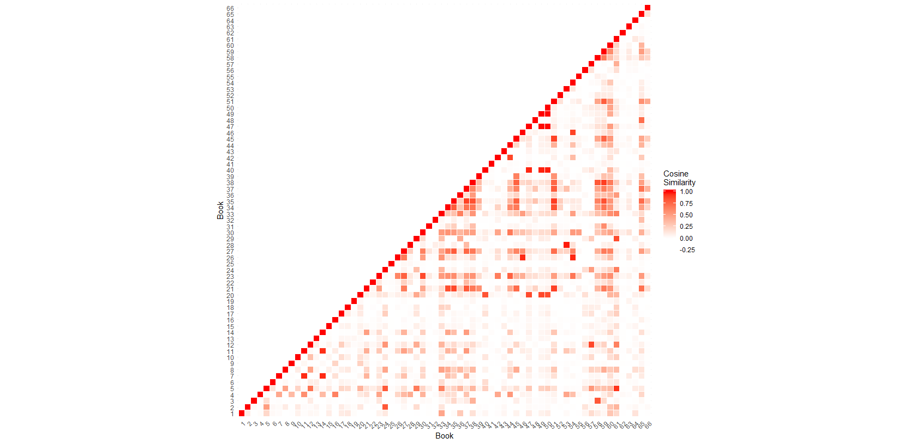
Outcome
Similarity score between books
Prophet books
Same Author
Notes:
Books 23-39 are Prophet book, which are poem. They are relatively concise and are most likely use core words frequently. Therefore, their content must have contained a lots of high tf-idf words in other books. From this finding, it seems to us that this model may better on predict the similarity of content instead of writing style. In addition, this model may not work well on comparing similarity of poem and other books.

Slide 22
Machine learning on Bible
Can machine understand Bible?
04
LDA and Clustering

Slide 23
LDA and Clustering preparation
Remove stop words,number, punctuation and frequent human name(Like God Jesus)
Words to vector
Create LDA models
Create Hierarchical
Cluster model
Calculate TF-IDF
(text insight)
Model validation and interpretation
Application: 1.Find author if there was an unknown passage
2.Decide topic of controversial passage

Slide 24
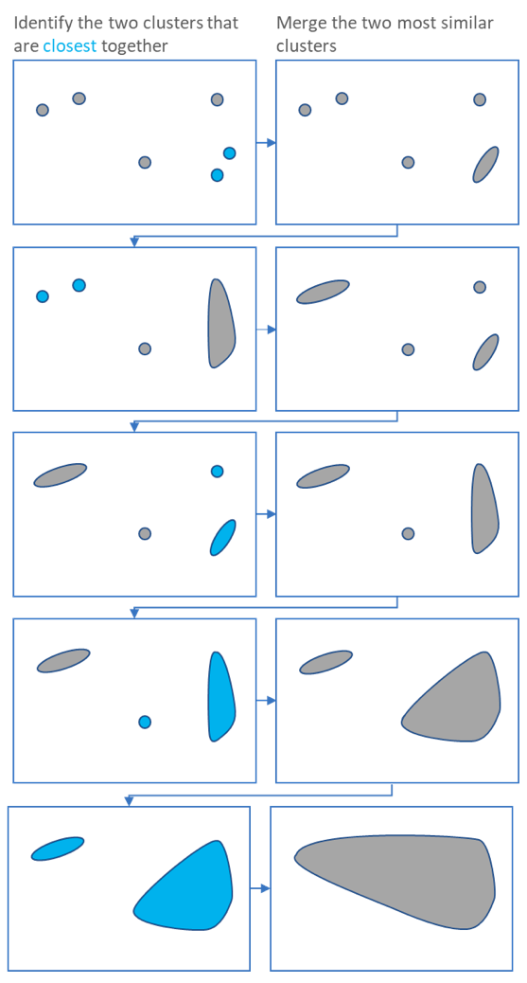
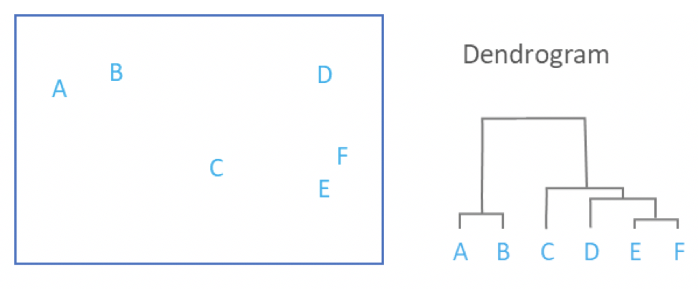
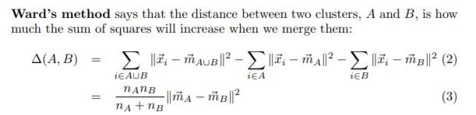
Brief Introduction of Hierarchical model
Ward's minimum variance method[Euclidean]

Slide 25
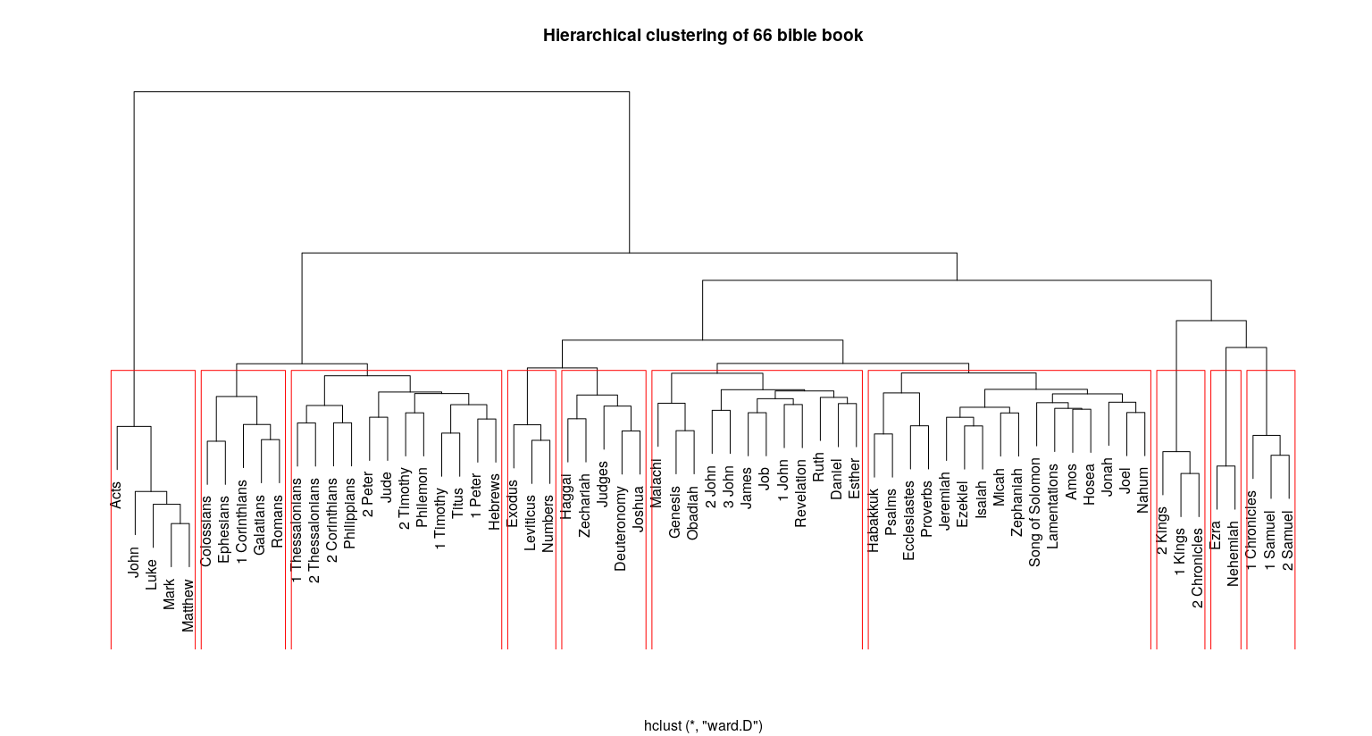
Unsupervised Hierarchical clustering

Slide 26
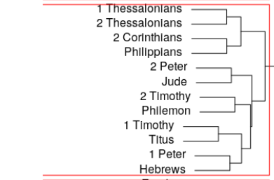
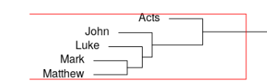
Cluster Interpret
5 books in cluster 1
12 books in cluster 3
Jesus’ Apostles’ letter to different churches
All about the Christian Faith and encourage them to stand firm
Lower 4 books are Gospel books all about life and teaching of Jesus(only 4 books about Jesus life), Acts is about history of Church

Slide 27
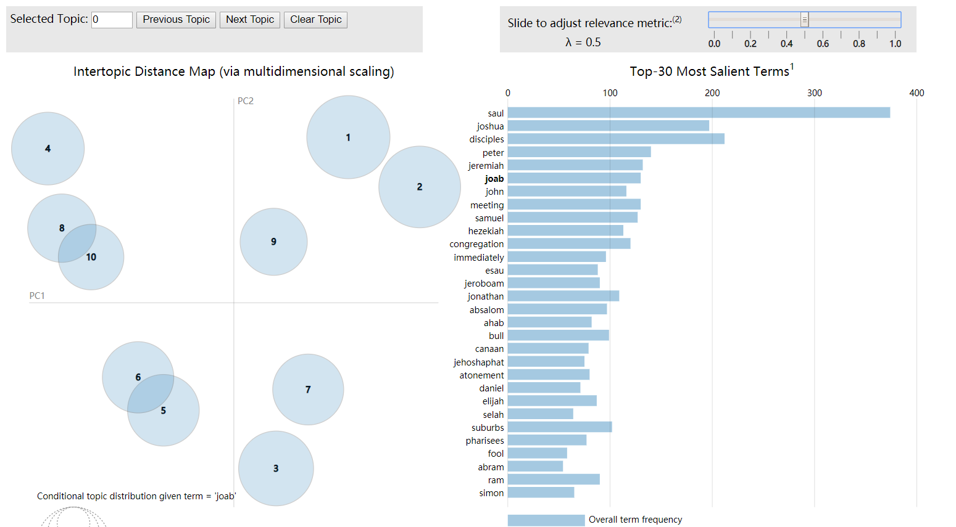
10 TOPICS LDA MODEL
In bible ,each book has several topics so it is hard to identify via a topic model.
There are too many topics in bible,contains almost everything
Topics are usually related to human name and place name.

Slide 28
Thank You

